Slide 1
Fridgify
Smart Recipe Recommender
A Personalized Recipe Solution to Reduce Food Waste and Simplify Meal Planning
Project update - Sprint 1
JK Team
Jingbo Wang, ChengKai Yang

Slide 2
Technical update – tech stack
Final list of APIs
On device sensors that will be used
Database schema
Any external libraries

Slide 3
Final list of APIs
Spoonacular API :
To fetch recipe data based on the user's inputted ingredients and preferences.
Google ML Kit:
Scans Barcode to fetch each ingredient details.
Firebase Authentication:
Provides a secure and easy way for users to create accounts and log in.
Firebase Analytics:
To track user behavior, preferences, and interactions, allowing for improved recommendations.

Slide 4
On device sensors that will be used
Camera
Used for scanning barcodes
Gyroscope and Accelerometer
Determines whether the user is keeping the device stable during the scanning process.
Ambient Light Sensor
Detects the light intensity of the surroundings.
Proximity Sensor
Avoid scanning barcodes that are too far away or incorrectly detected.
Flashlight
Automatically turns on the device's flash when ambient light is low to improve the accuracy of barcode scanning.

Slide 5
Database Schema
Users Table (Stores user information for personalization and login purposes.)
Columns:
user_id (Primary Key, Auto Increment)
username (Text, Unique)
email (Text, Unique)
password (Text, Hashed)
preferences (Text, JSON: stores dietary preferences and restrictions)
created_at (Timestamp)
Ingredients Table (Stores ingredients entered by the user.)
Columns:
ingredient_id (Primary Key, Auto Increment)
user_id (Foreign Key -> Users.user_id)
ingredient_name (Text)
quantity (Text, e.g., "2 cups", "500g")
expiration_date (Date, nullable for non-expiring items)
added_at (Timestamp)

Slide 6
Database Schema
Recipes Table (Stores recipes fetched from the API or created by users.)
Columns:
recipe_id (Primary Key, Auto Increment)
recipe_name (Text)
instructions (Text, JSON or Markdown format)
prep_time (Integer, in minutes)
cook_time (Integer, in minutes)
calories (Integer, nullable)
nutrition (Text, JSON: stores macronutrient data)
is_favorite (Boolean, for user bookmarking)
Recipe Ingredients Table (Stores the many-to-many relationship between recipes and ingredients.)
Columns:
cache_id (Primary Key, Auto Increment)
user_id (Foreign Key -> Users.user_id)
cached_data (Text, JSON: stores recipes and user interactions)
cached_at (Timestamp)

Slide 7
Database Schema
Offline Cache Table (Caches recipes and user actions for offline functionality.)
Columns:
cache_id (Primary Key, Auto Increment)
user_id (Foreign Key -> Users.user_id)
cached_data (Text, JSON: stores recipes and user interactions)
cached_at (Timestamp)
Analytics Table (Tracks user activity for Firebase Analytics integration.)
Columns:
event_id (Primary Key, Auto Increment)
user_id (Foreign Key -> Users.user_id)
event_type (Text, e.g., "recipe_viewed", "ingredient_added")
event_data (Text, JSON: details about the event)
event_time (Timestamp)
Relationship Diagram
Users → 1-to-many → Ingredients
Users → 1-to-many → Recipes Recipes → many-to-many → Ingredients through Recipe Ingredients
Users → 1-to-many → Offline Cache
Users → 1-to-many → Analytics

Slide 8
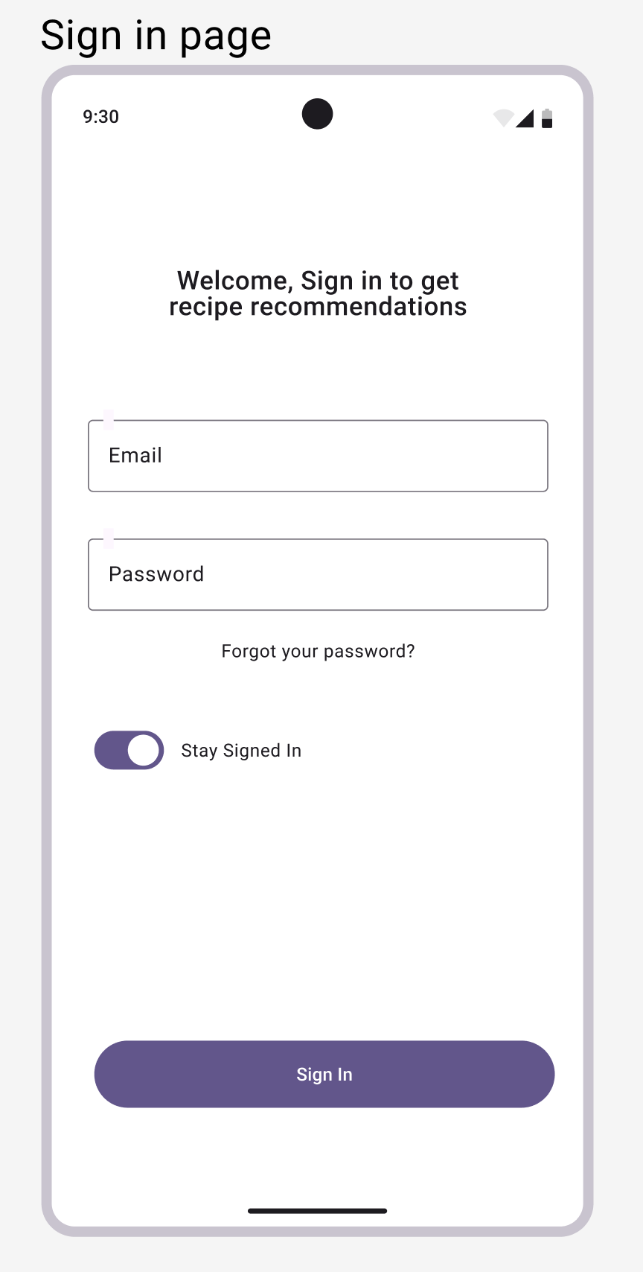
Preliminary UI Design
Ingredient input screen: user inputs existing ingredients
Recommendation page: shows recommended recipes based on ingredients
Recipe details page: detailed cooking steps and nutritional information.
Preferences: Allows user to set dietary preferences, taboos, etc.

Slide 9
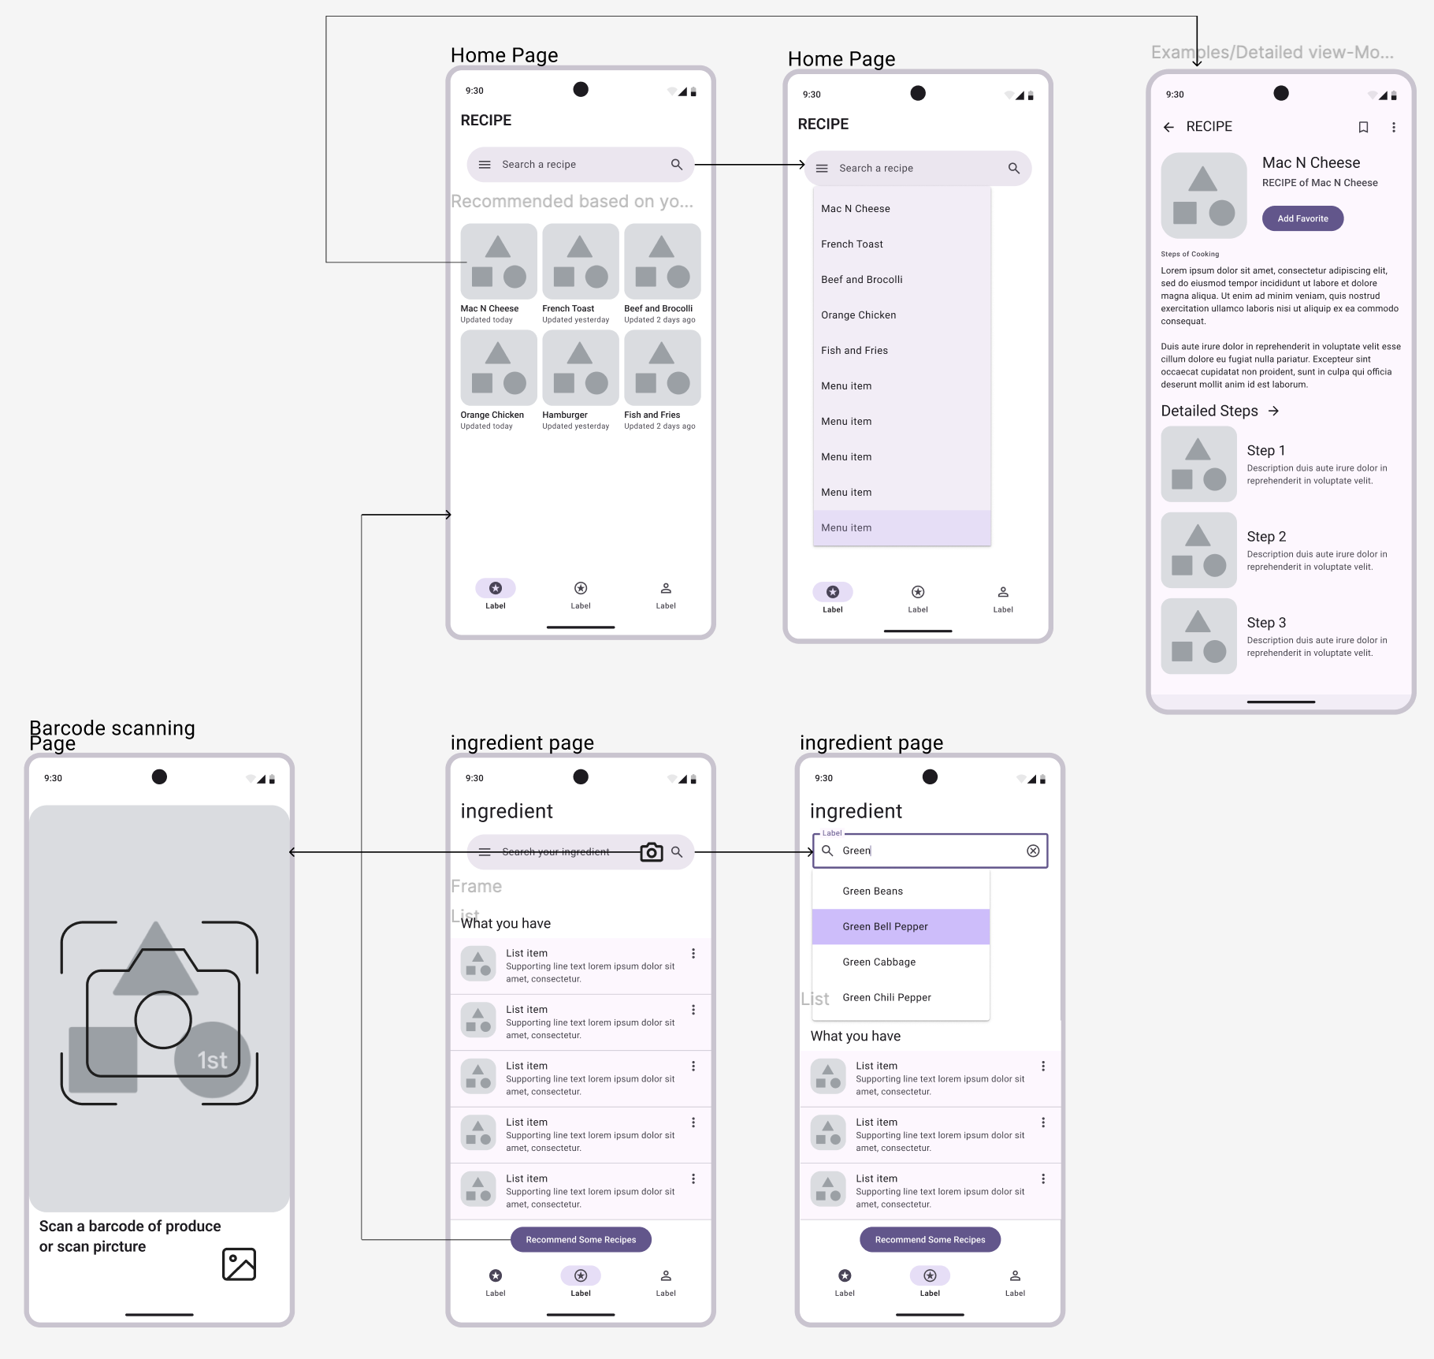
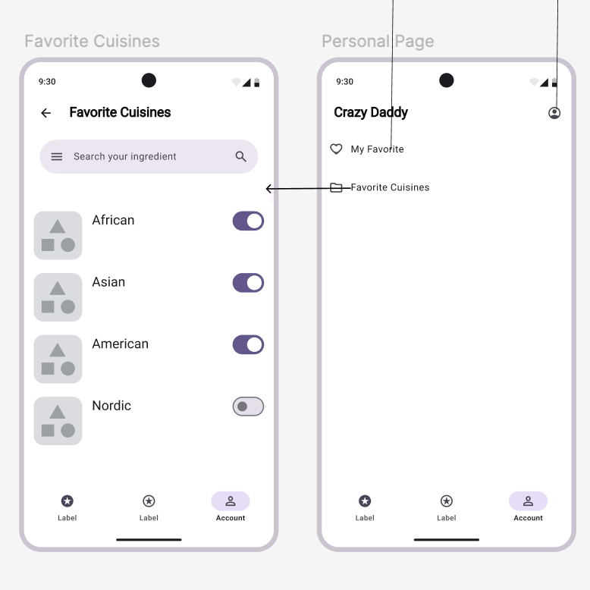

Slide 10
What teammates accomplished
Jingbo Wang:
UI design
API research
Device Sensors research
Chengkai Yang:
UI design
API research
Database Schema design

Slide 11
Demo

Slide 12
Thank You!

